Slide 1
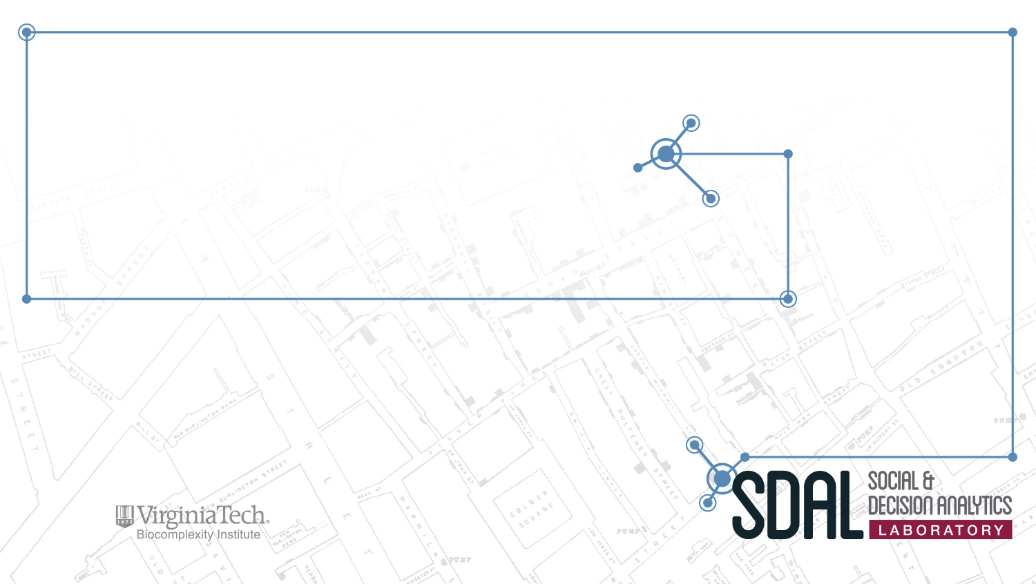
Local Characterization of Refugee Social Contexts in Place and Time: Insights from local data sources
SDAL Faculty Lead: Mark Orr

Slide 2
Local Characterization of Refugee Social Contexts in Place and Time: Insights from local data sources
SDAL Faculty Lead: Mark Orr
SDAL Team: Stephanie Shipp, Bianica Pires

Slide 3
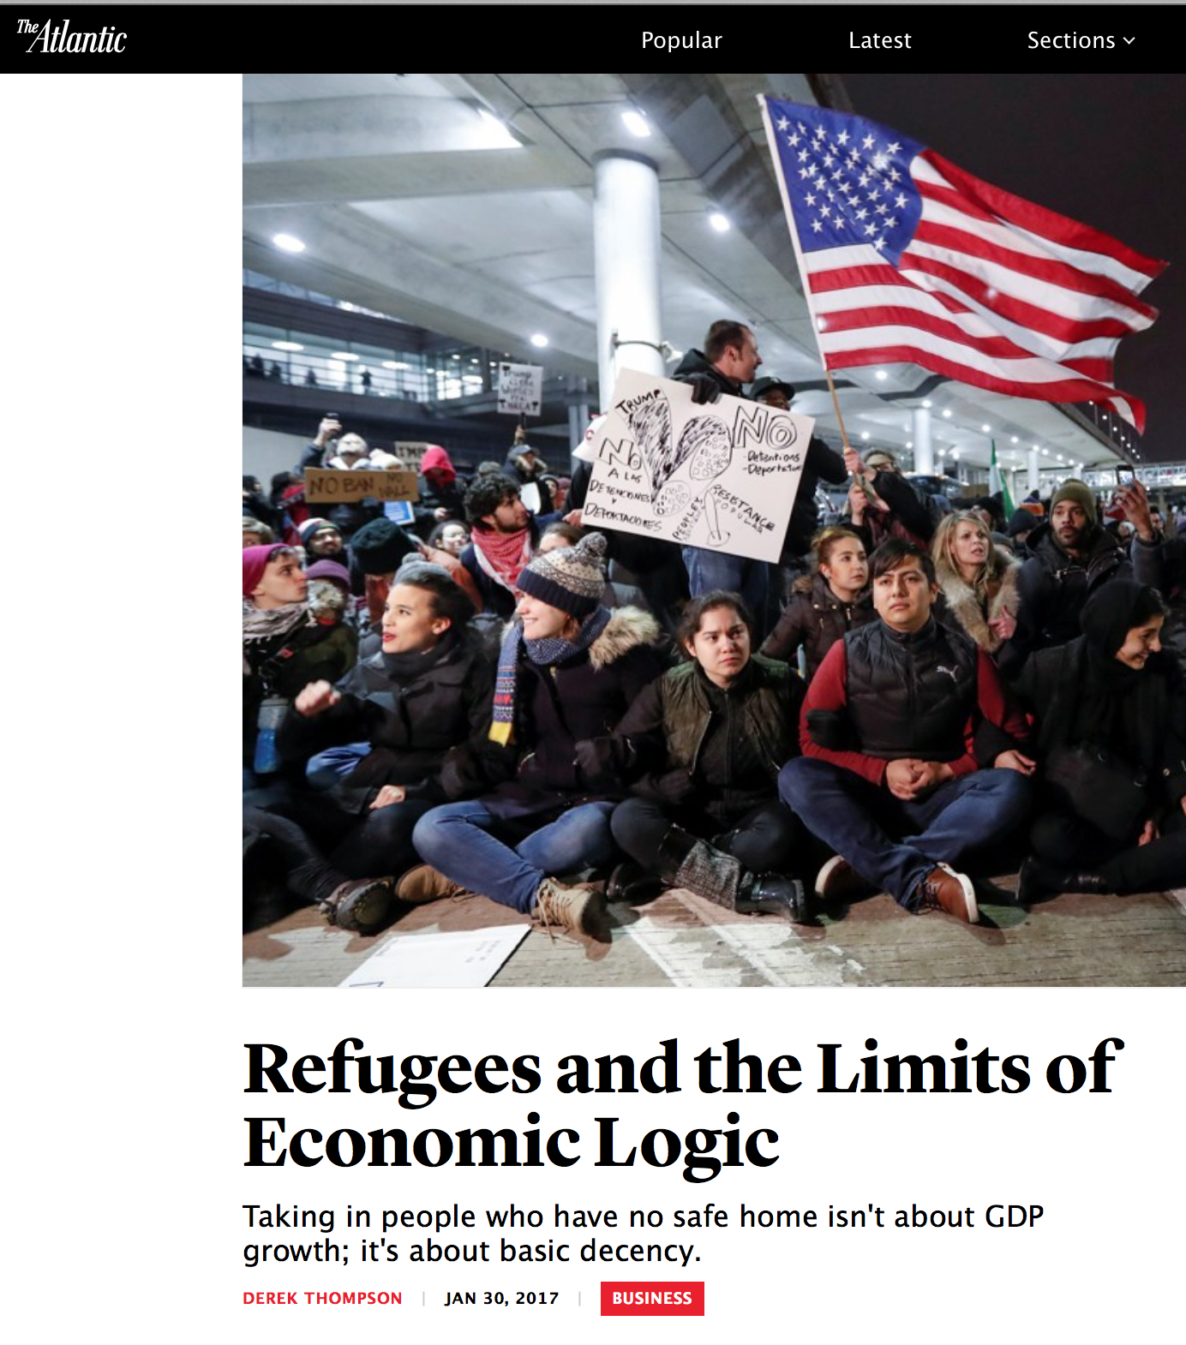
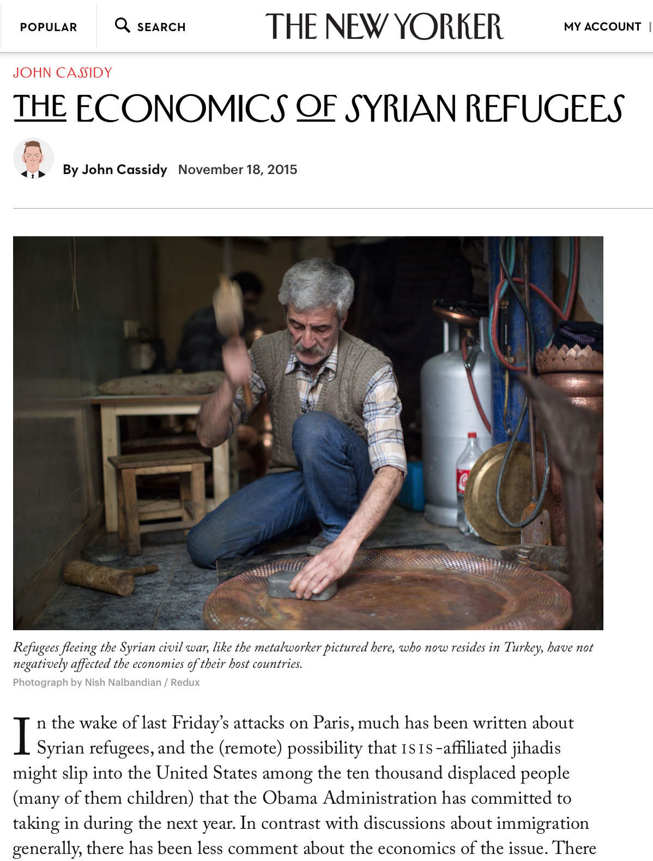
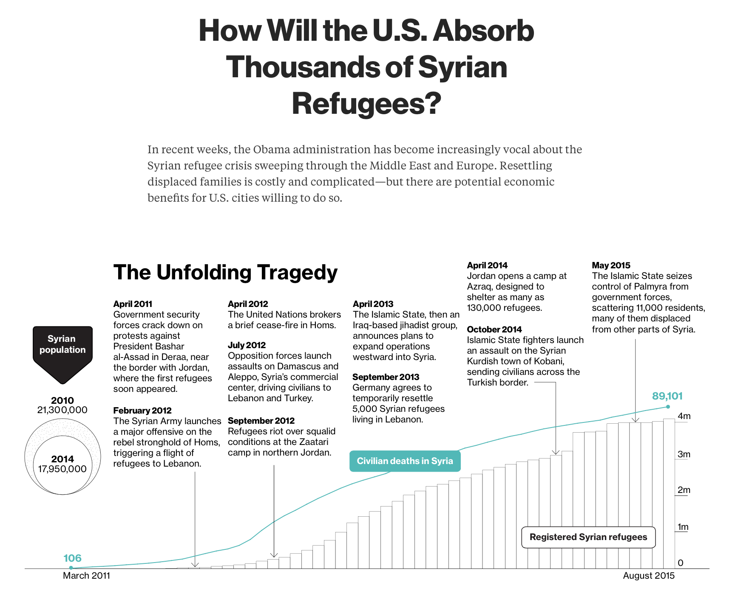
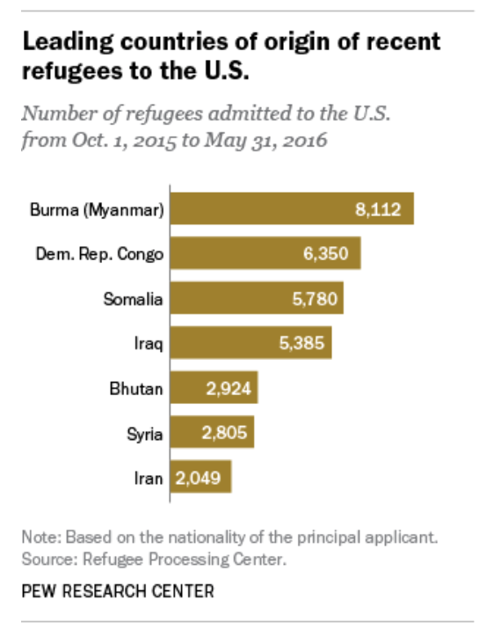

Slide 5
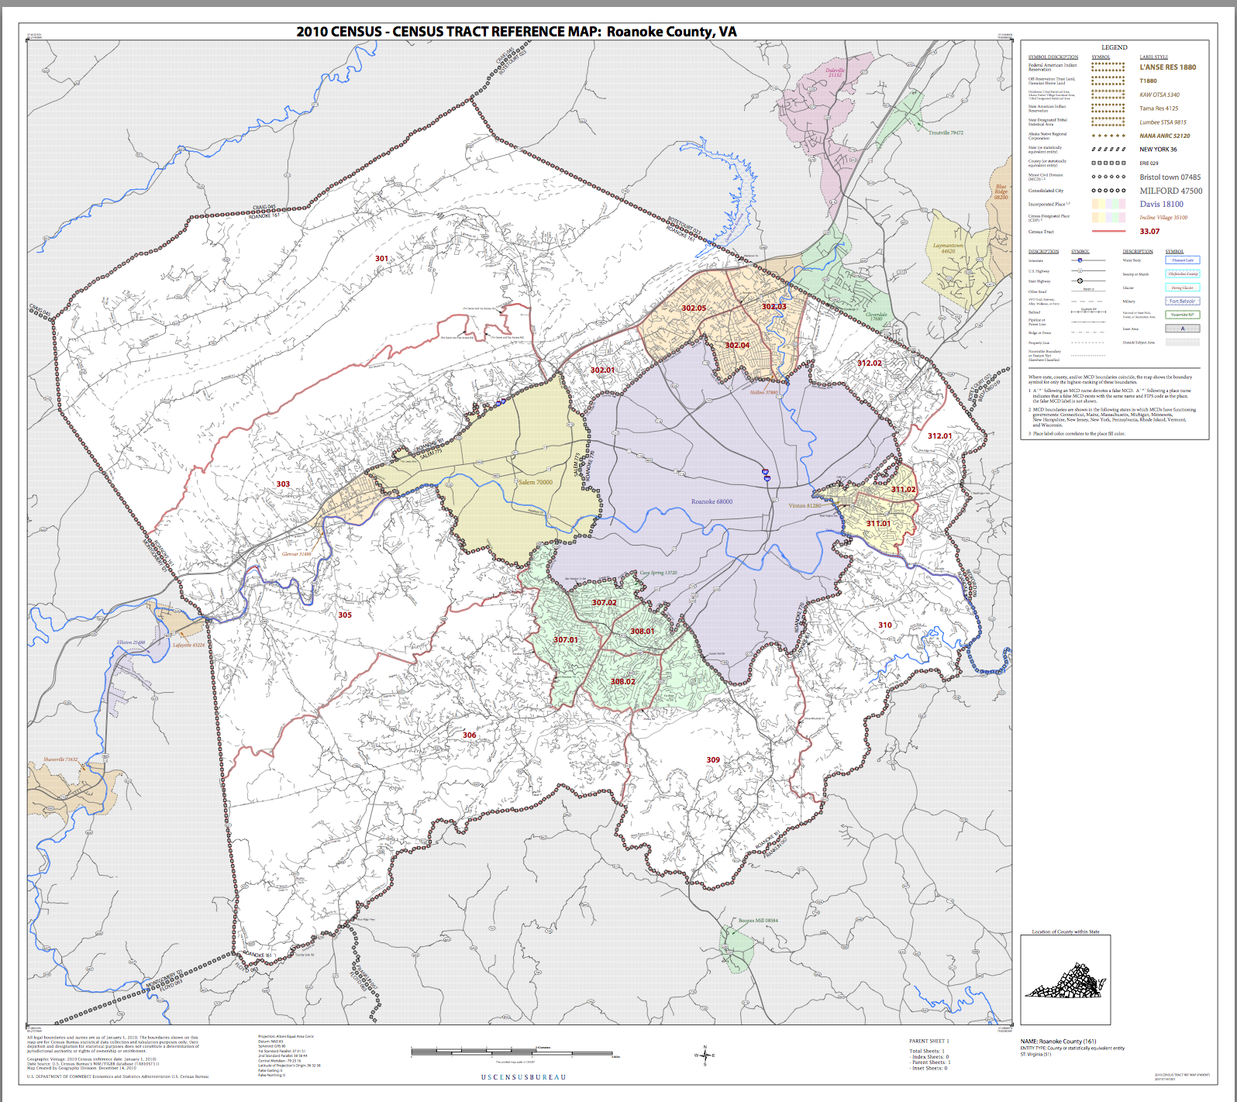
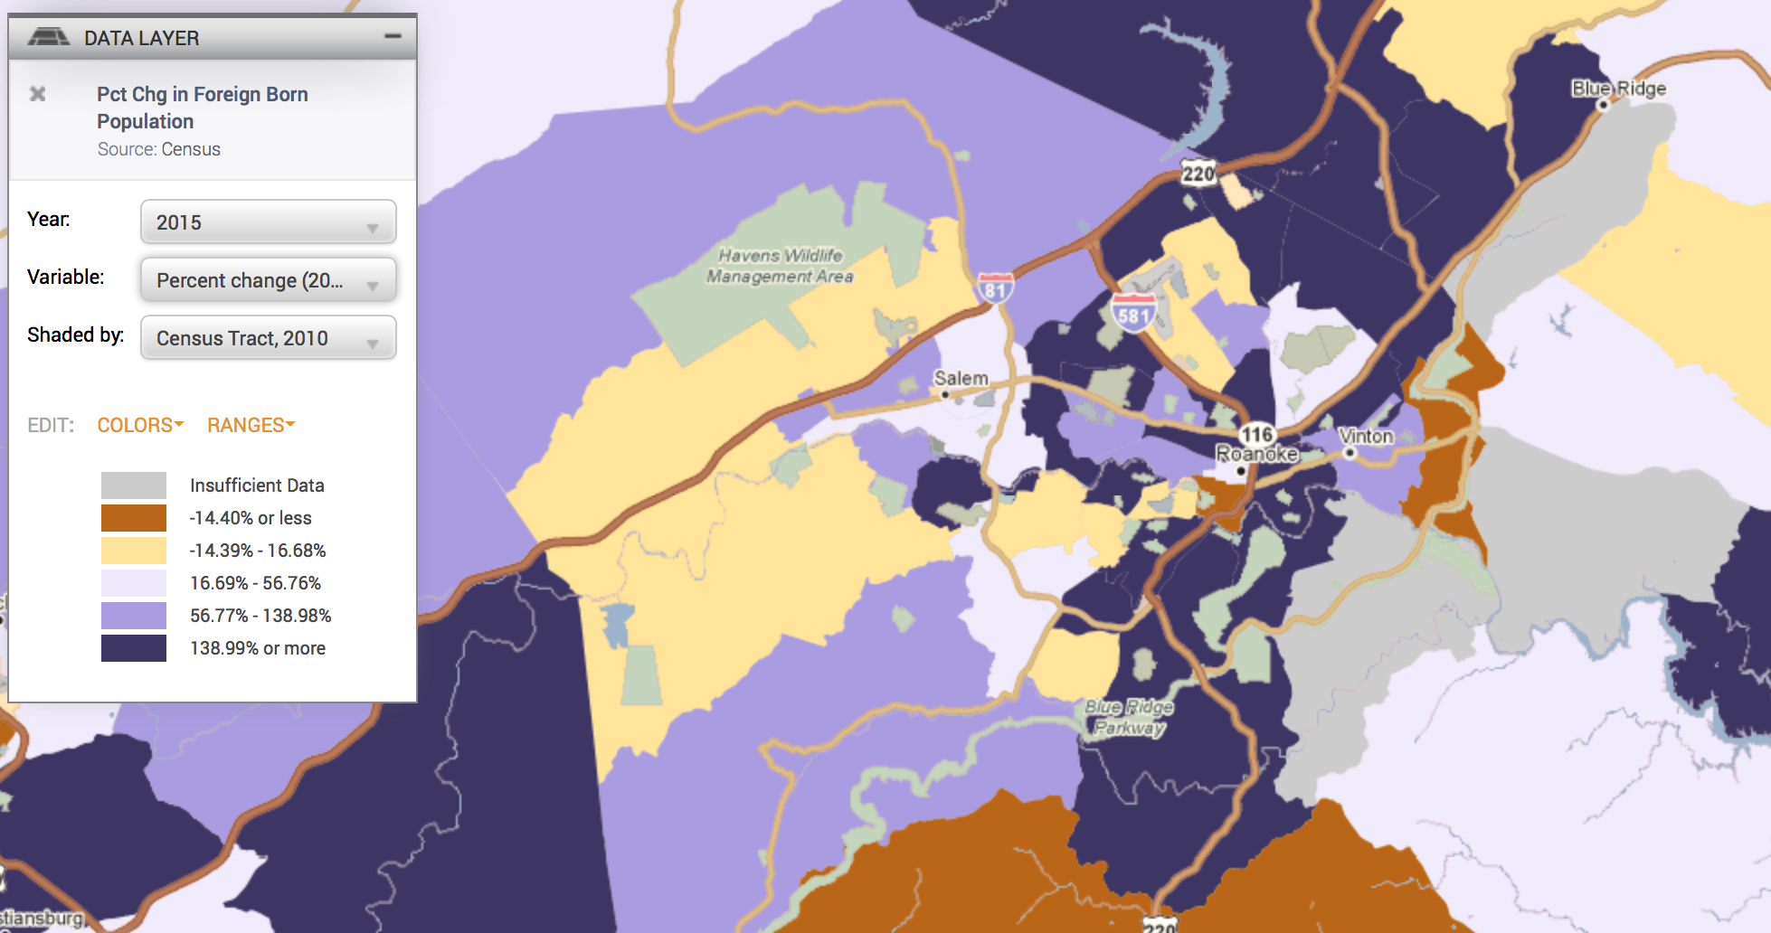
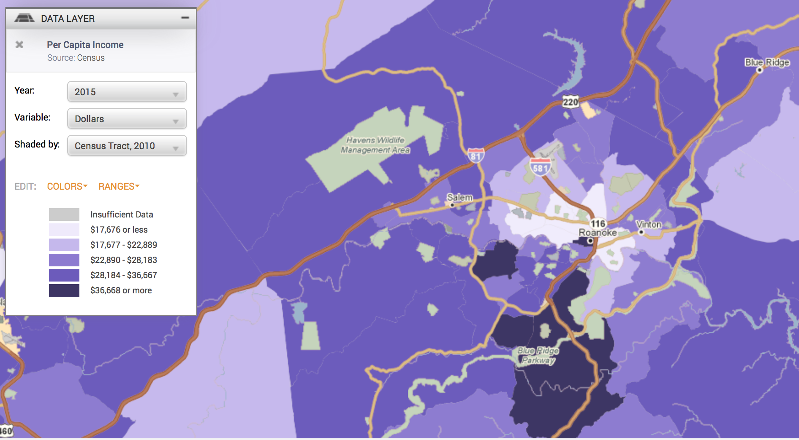
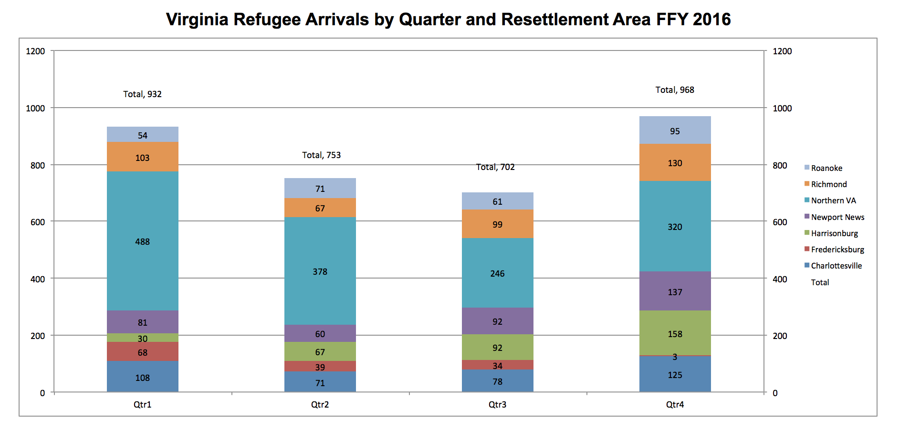

Slide 6
Project Objectives
Issues/Contexts
Across Scales (G → L)
--Substantive
--Methodological/Empirical
--Ethical
--Policy
Data Discovery
--Fed, state, local
--Criminal Justice, economic, education, health, etc.
--All data
Focused
Product
E.G.:
-Provide insight into substantive issue for policy
recommendation
-Solve a technical issue (small n)
-Introduce new and useful data type(s)

